Slide 1

NATIONAL INSTITUTE OF TECHNOLOGY WARANGAL
PROJECT WORK - A
ENERGY THEFT DETECTION USING MACHINE LEARNING ALGORITHMS
Supervised by
Prof. M. Sailaja Kumari
Presented by
Raghav Rath (202249)
Kruthi pranada (202218)

Slide 2
INTRODUCTION
The objective of electricity theft detection is to detect unusual activities in the electricity usage of a smart meter.
Theft can be detected by checking for abnormalities in the user’s electricity consumption patterns.
The worst-hit are the developing economies.
Power theft and its illegal consumption results in immense economic loss for many countries such as India Rs 3,000 crores annually.
Power utilities are losing about 21 Billion Dollars globally, as power theft every year.

Slide 3
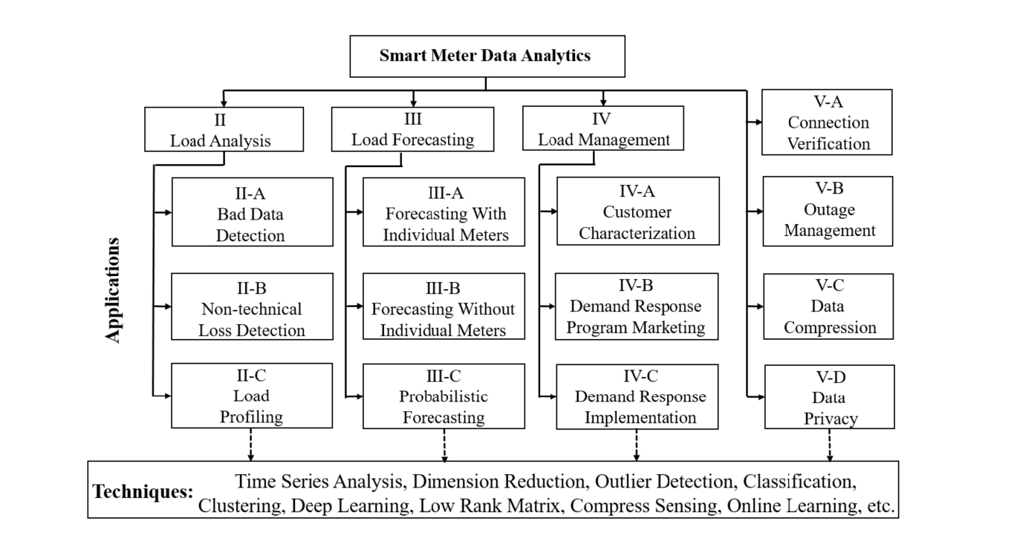
Y. Wang, Q. Chen, T. Hong, and C. Kang, “Review of Smart Meter Data Analytics: Applications, Methodologies, and Challenges,” in IEEE Transactions on Smart Grid, vol. 10, no. 3, pp. 3125-3148, May 2019, doi: 10.1109/TSG.2018.2818167.
https://ieeexplore.ieee.org/abstract/document/8322199

Slide 4
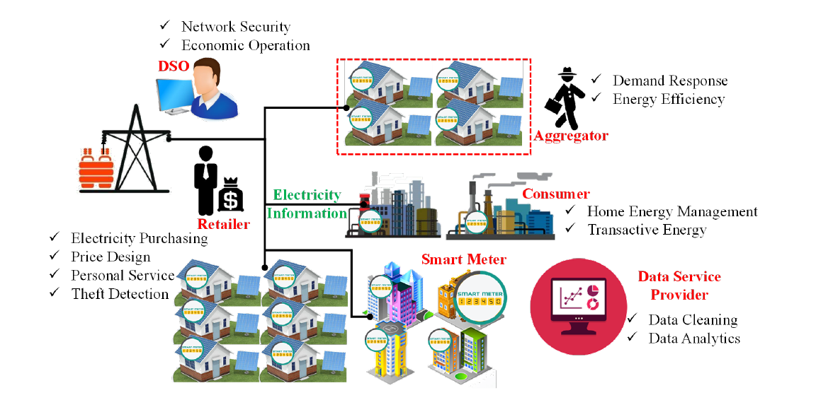
Y. Wang, Q. Chen, T. Hong, and C. Kang, “Review of Smart Meter Data Analytics: Applications, Methodologies, and Challenges,” in IEEE Transactions on Smart Grid, vol. 10, no. 3, pp. 3125-3148, May 2019, doi: 10.1109/TSG.2018.2818167.
https://ieeexplore.ieee.org/abstract/document/8322199

Slide 5
CONTENTS
INTRODUCTION
WORK DONE TILL MID
WORK DONE AFTER MID
Data Collection
Data Analysis
Modelling
Results
Conclusions
Objectives for Next Semester

Slide 6
WORK DONE TILL MID
Problem Statement Selection
Literature Review
Data collection

Slide 7
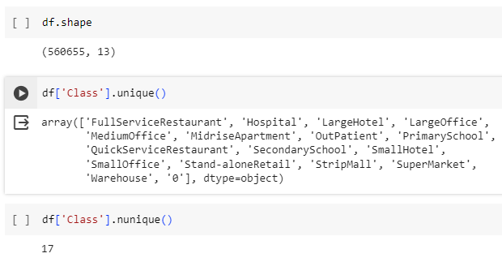
DATA SUMMARY
Data Statistics:
No of consumer types: 17
No of records: 5,60,655
No of features: 13
Columns Derived:
Total Energy
New Theft (Label)
S. Zidi, A. Mihoub, S. M. Qaisar, M. Krichen, and Q. Abu Al-Haija, “Theft detection dataset for benchmarking and machine learning based classification in a smart grid environment,” in Journal of King Saud University – Computer and Information Sciences, Received 21 February 2022, Revised 12 April 2022, Accepted 11 May 2022, Available online 17 May 2022.
https://www.researchgate.net/publication/360554845_Theft_Detection_Dataset_for_Benchmarking_and_Machine_Learning_based_Classification_in_a_Smart_Grid_Environment
DATASET:
https://data.mendeley.com/datasets/c3c7329tjj/1

Slide 8
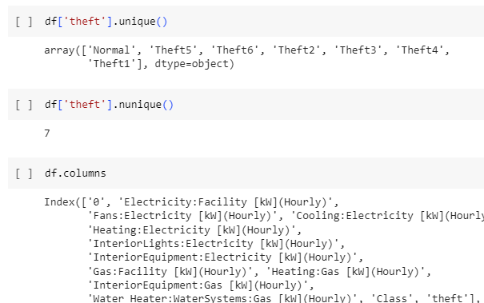
DATA SUMMARY
Theft types:
Theft 1: Considerable reduction of electricity consumption during the day.
Theft 2: Electricity consumption drops to zero at random and during an arbitrary period.
Theft 3: Consumption value (each hour) is multiplied by a random number.
Theft 4: A random fraction of the mean consumption.
Theft 5: The mean consumption.
Theft 6: Reverses the order of readings.

Slide 9
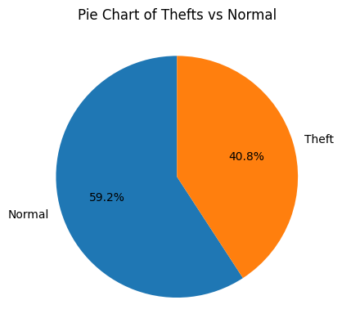
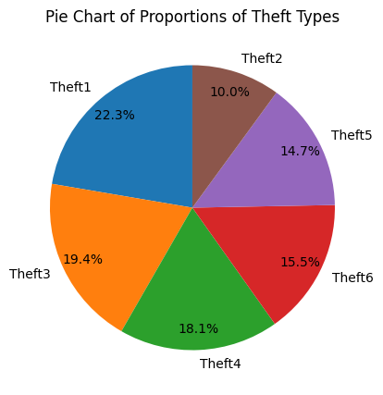
DATA ANALYSIS

Slide 10
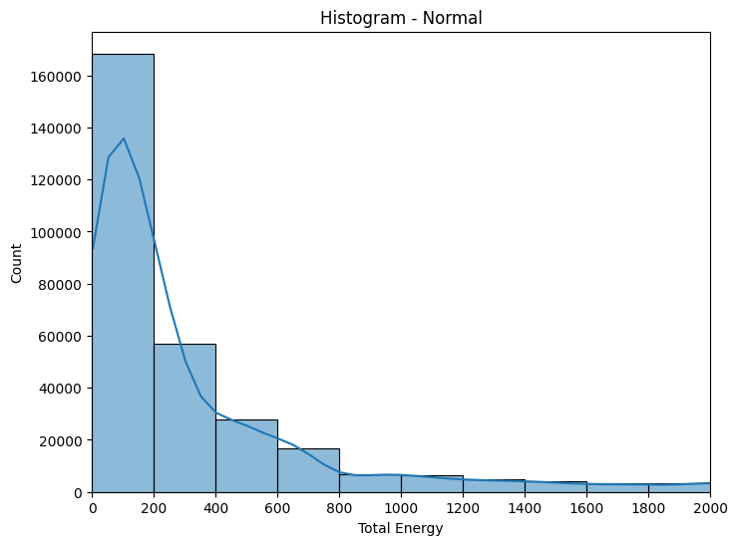
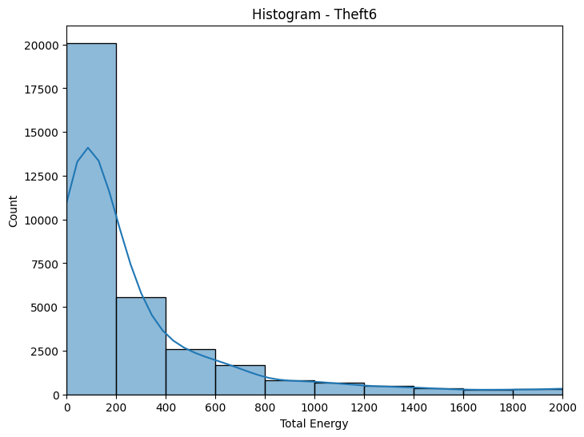
DATA ANALYSIS

Slide 11
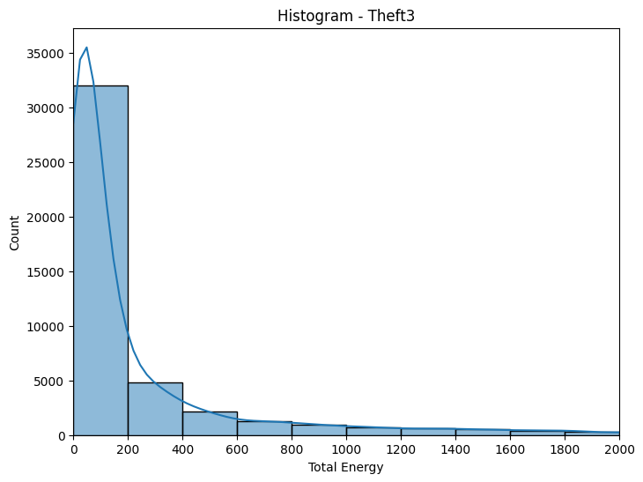
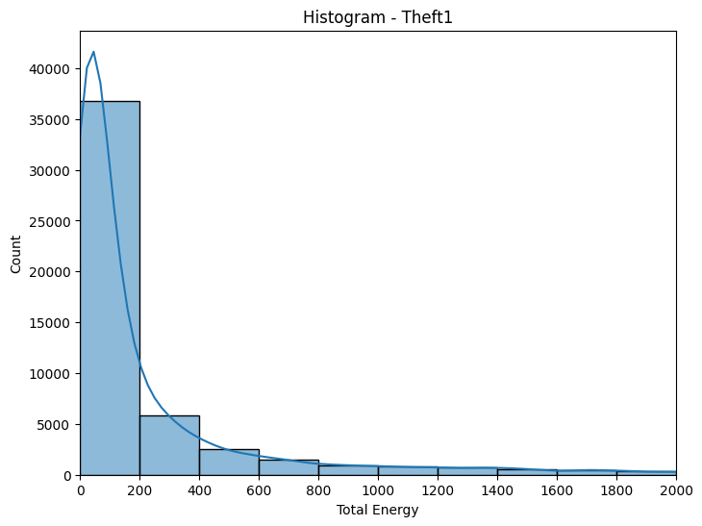
DATA ANALYSIS

Slide 12
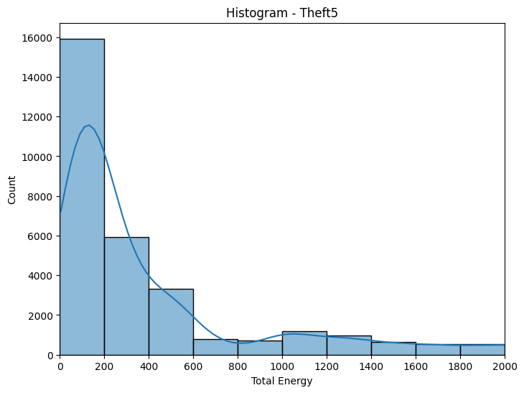
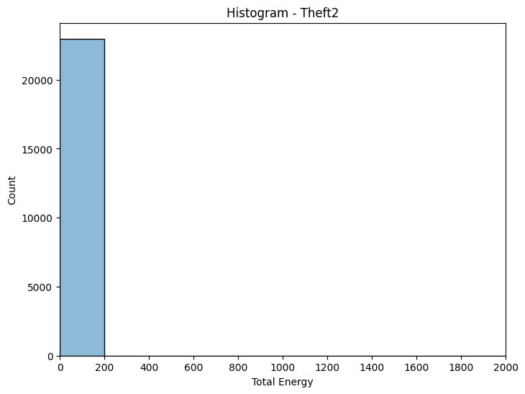
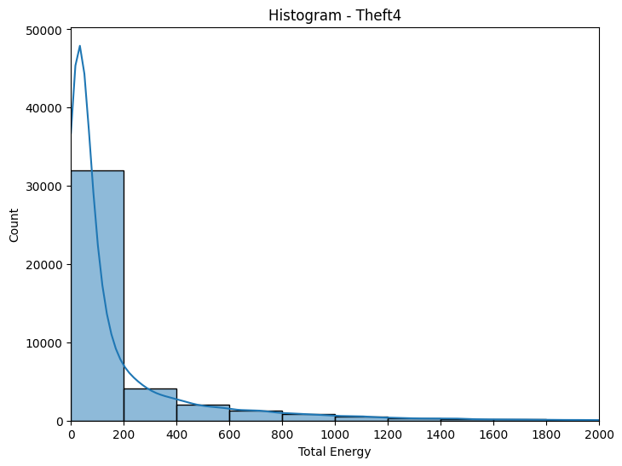
DATA ANALYSIS

Slide 13
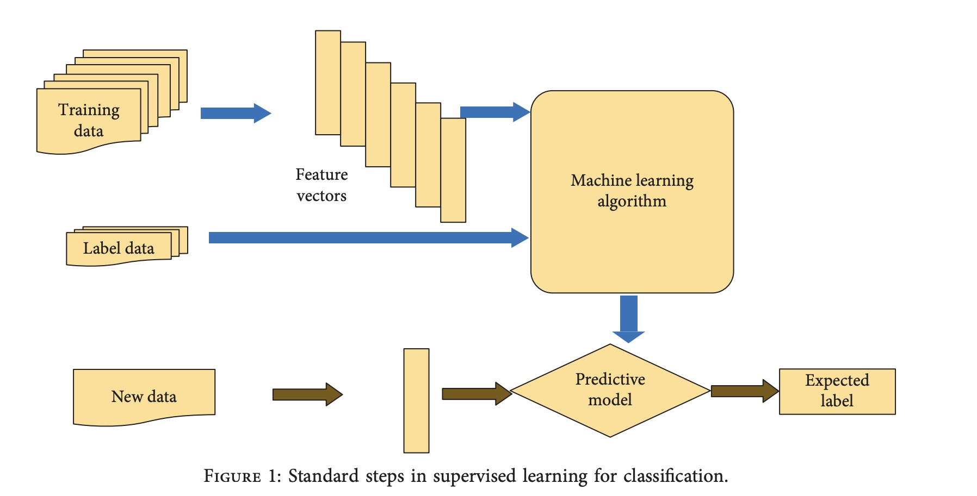

Slide 14
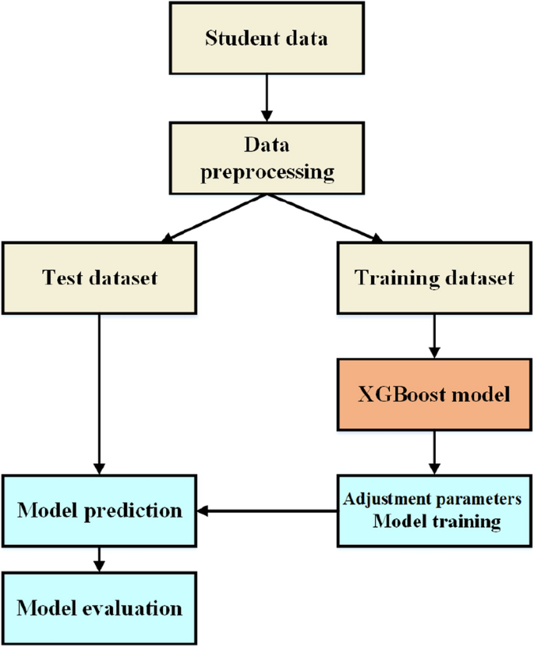
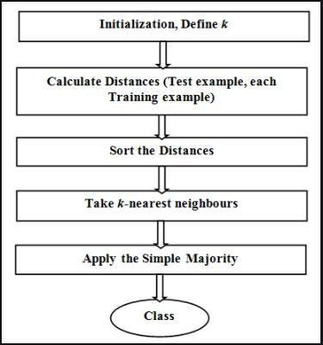
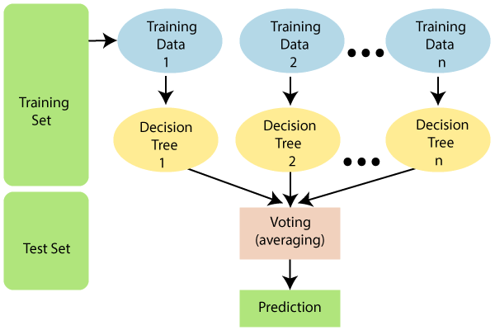
RANDOM FOREST
CLASSIFIER
XGBOOST
CLASSIFIER
KNN
CLASSIFIER

Slide 15
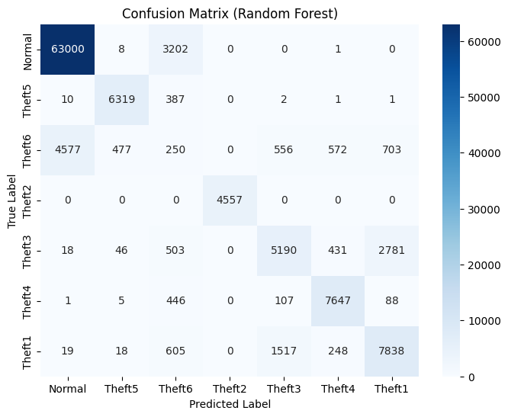
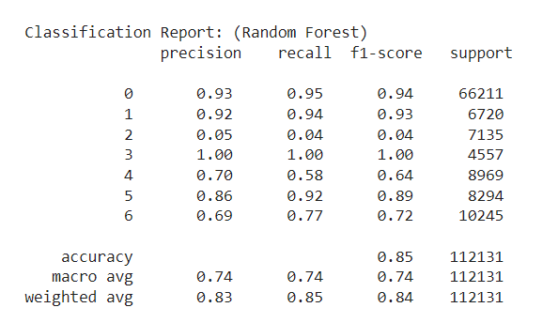
MODEL RESULTS (RANDOM FOREST)
Prediction on the test data

Slide 16
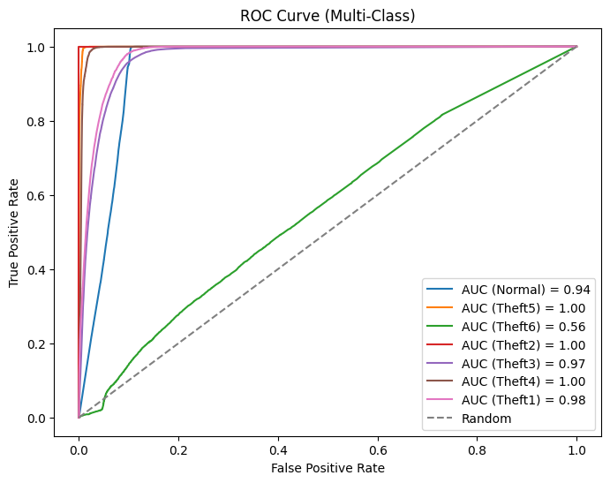
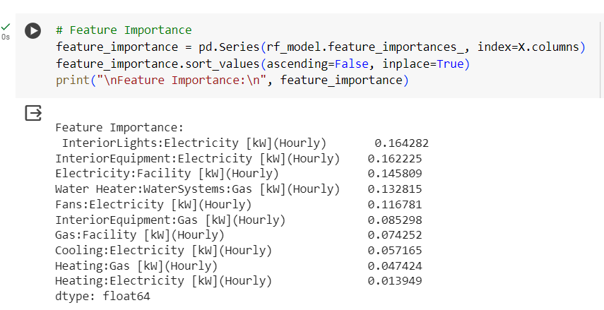
MODEL RESULTS (RANDOM FOREST)

Slide 17
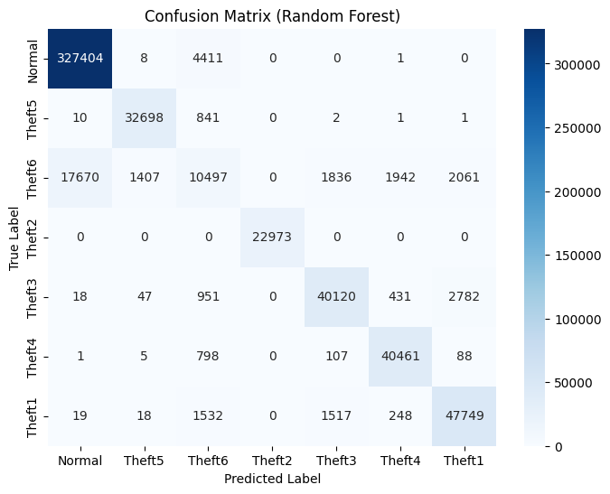
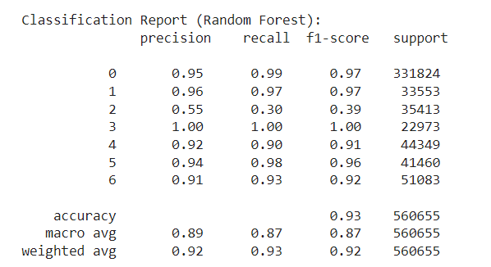
MODEL RESULTS (RANDOM FOREST)
Prediction on the entire dataset

Slide 18
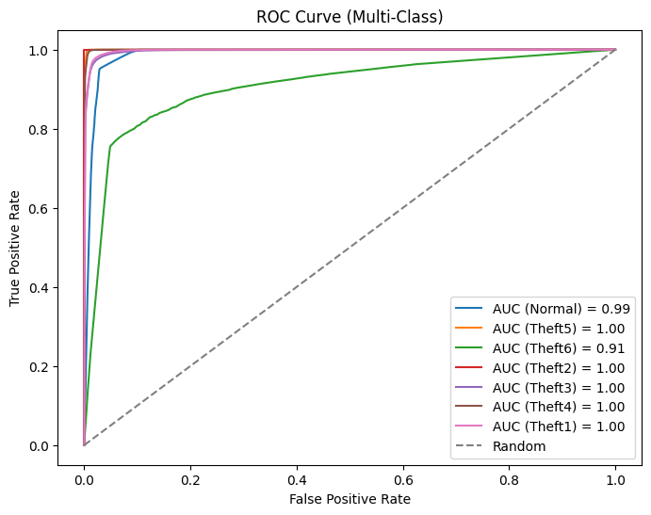
MODEL RESULTS (RANDOM FOREST)

Slide 19
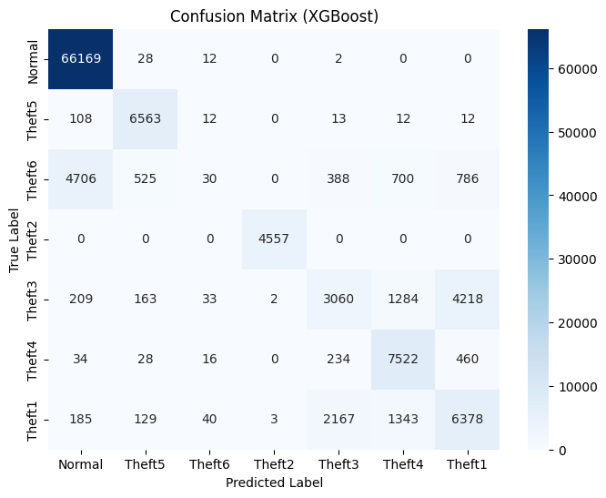
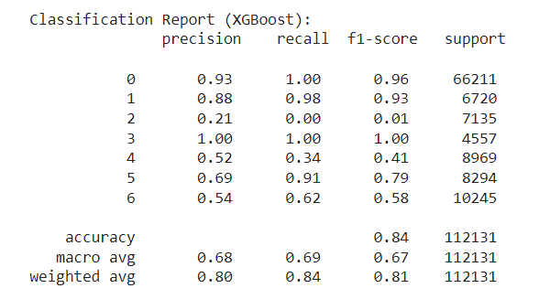
MODEL RESULTS (XGBoost)
Prediction on the test data

Slide 20
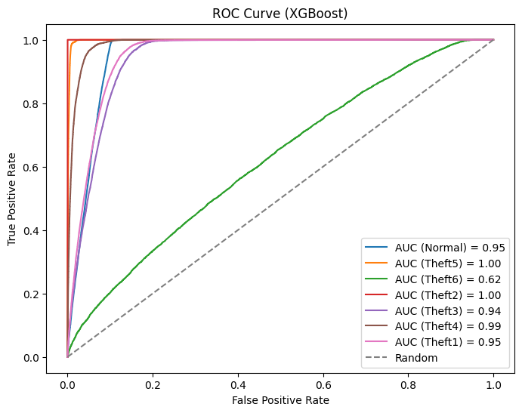
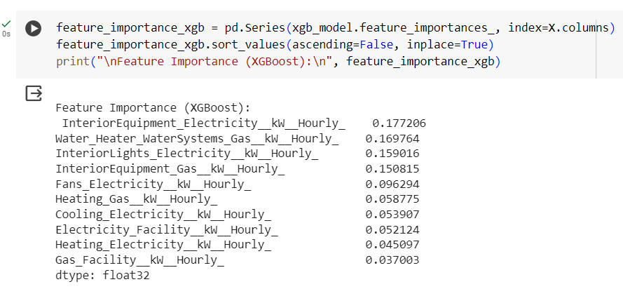
MODEL RESULTS (XGBoost)

Slide 21
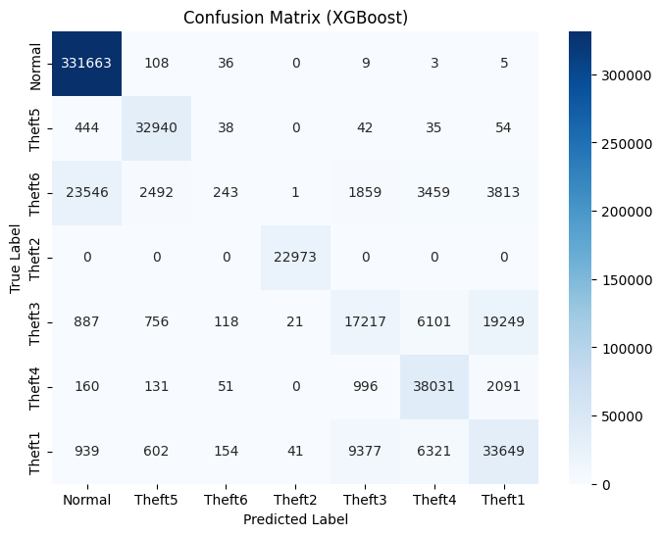
MODEL RESULTS (XGBoost)
Prediction on the entire dataset

Slide 22
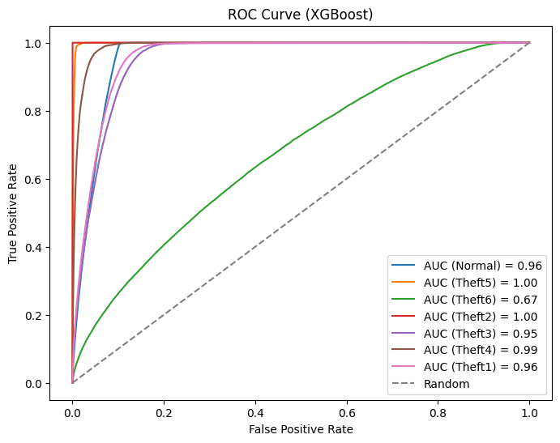
MODEL RESULTS (XGBoost)

Slide 23
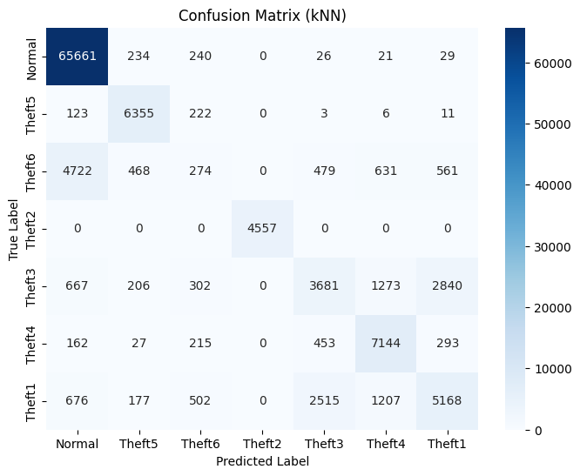
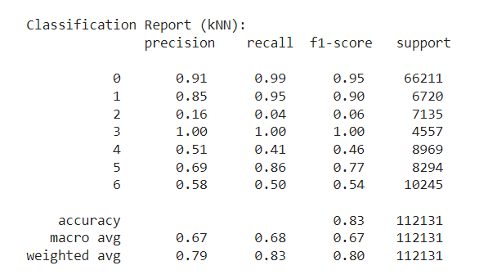
MODEL RESULTS (kNN)
Prediction on the test data

Slide 24
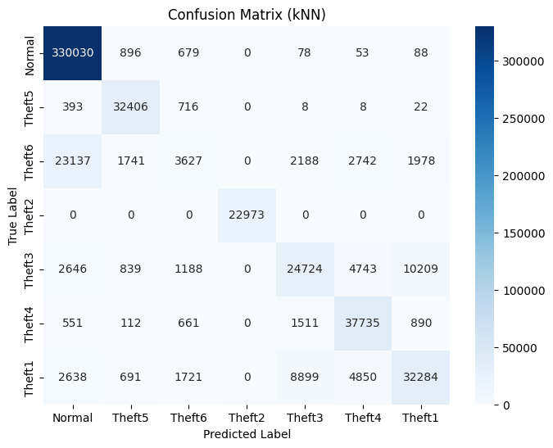
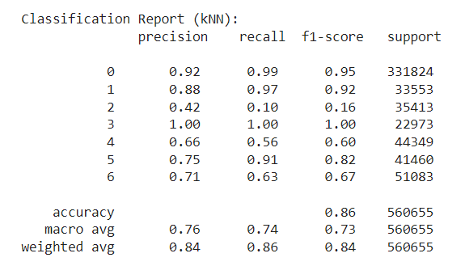
MODEL RESULTS (kNN)
Prediction on the entire dataset

Slide 25
CONCLUSIONS
Random Forest is the best ML model with the highest accuracy of 85%.
The predictions except for identifying ‘Theft6’ are almost correct with very high precision and recall values.
XGBoost gives an accuracy of 84%.
However, XGBoost makes an error in identifying many ‘Theft3’ instances as ‘Theft1’ apart from ‘Theft6’.
There’s a considerable error in detecting in ‘Theft1’ also by XGBoost.
kNN gives an accuracy of 83%.
It also works similar to XGBoost.
Despite identifying ‘Theft3’ better than XGBoost, it still identifies many instances as ‘Theft1’ and vice versa.
Therefore, Random Forest is the ML model with the best performance.

Slide 26
CONCLUSIONS
For prediction on the entire dataset -
The accuracy of -
Random Forest has increased significantly from 85% to 93%.
kNN has increased slightly from 83% to 86%.
XGBoost is still the same.
Random Forest predicts ‘Theft6’ significantly better (AUC of ROC has increased).
The precision of ‘Theft1’ and ‘Theft3’ prediction has increased significantly for kNN.
Random Forest shows better performance w.r.t all labels in prediction.
There is absolutely no change in the prediction performance of the XGBoost model.

Slide 27
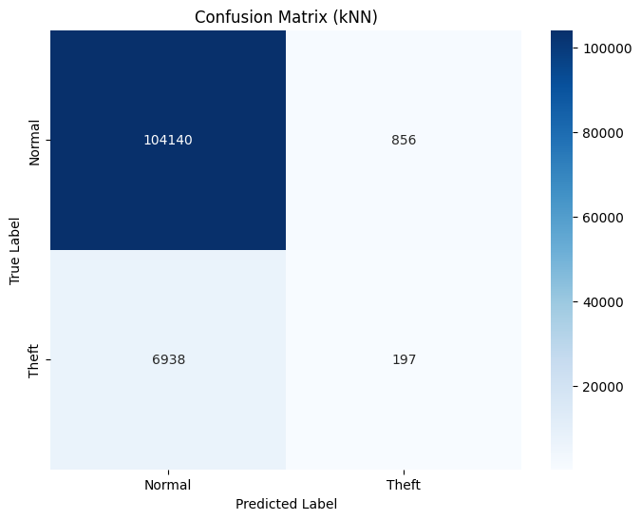
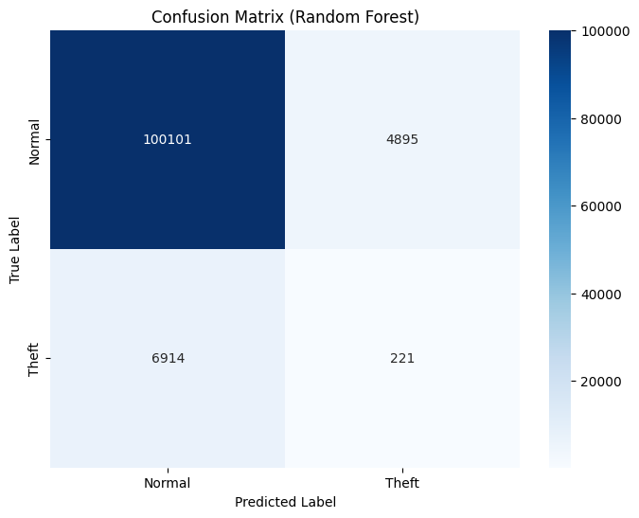
OBJECTIVES for NEXT SEMESTER
Results after all theft labels were labelled as normal except for ‘Theft6’.

Slide 28

OBJECTIVES for NEXT SEMESTER
‘Theft6’ is still not getting detected properly by any of the classifiers.
Test different techniques to resolve the ‘Theft6’ detection failure.

Slide 29
REFERENCES
Dataset: https://data.mendeley.com/datasets/c3c7329tjj/1
Y. Wang, Q. Chen, T. Hong, and C. Kang, “Review of Smart Meter Data Analytics: Applications, Methodologies, and Challenges,” in IEEE Transactions on Smart Grid, vol. 10, no. 3, pp. 3125-3148, May 2019, doi: 10.1109/TSG.2018.2818167.
https://ieeexplore.ieee.org/abstract/document/8322199
S. Zidi, A. Mihoub, S. M. Qaisar, M. Krichen, and Q. Abu Al-Haija, “Theft detection dataset for benchmarking and machine learning based classification in a smart grid environment,” in Journal of King Saud University – Computer and Information Sciences, Received 21 February 2022, Revised 12 April 2022, Accepted 11 May 2022, Available online 17 May 2022.
https://www.researchgate.net/publication/360554845_Theft_Detection_Dataset_for_Benchmarking_and_Machine_Learning_based_Classification_in_a_Smart_Grid_Environment
R. Punmiya and S. Choe, "Energy Theft Detection Using Gradient Boosting Theft Detector With Feature Engineering-Based Preprocessing," in IEEE Transactions on Smart Grid, vol. 10, no. 2, pp. 2326-2329, March 2019, doi: 10.1109/TSG.2019.2892595.
https://ieeexplore.ieee.org/stamp/stamp.jsp?tp=&arnumber=8610248
Z. A. Khan, M. Adil, N. Javaid, M. N. Saqib, M. Shafiq, and J. G. Choi, “Electricity Theft Detection Using Supervised Learning Techniques on Smart Meter Data,” in Sustainability, vol. 12, no. 19, pp. 8023, September 28, 2020, doi: 10.3390/su12198023.
https://www.mdpi.com/2071-1050/12/19/8023
J. Y. Kim, Y. M. Hwang, Y. G. Sun, I. Sim, D. I. Kim, and X. Wang, “Detection for Non-Technical Loss by Smart Energy Theft With Intermediate Monitor Meter in Smart Grid,” in IEEE Access, vol. 7, pp. 129043-129053, September 11, 2019, doi: 10.1109/ACCESS.2019.2940443.
https://ieeexplore.ieee.org/stamp/stamp.jsp?tp=&arnumber=8832141

